Slide 1
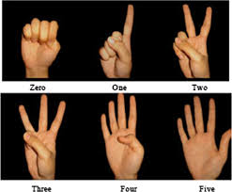
Virtual Calculator controlled by Hand Gestures

Slide 2

Group Member Information
Chinmayee Pendyala – 700746587
Lakshmi Harshita Rudraraju - 700746371
Manasa Vathumilli – 700745467
Nakshathra Racha – 700745072

Slide 3

Role/Responsibilities and Contribution
Nakshathra Racha– Data Collection/ Curation, Feature Engineering
Chinmayee Pendyala –Model Development, Virtual Calculator implementation
Lakshmi Harshita Rudraraju– Model development, Virtual Calculator implementation
Manasa Vathumilli- Feature Engineering , Evaluation

Slide 4

Motivation
The primary reason for developing a virtual calculator that responds to hand gestures is to give people who might find it challenging to use traditional physical calculators or keyboards an alternative input option.
The purpose of this gadget is to provide accessibility and convenience, particularly for those who are physically limited or have disabilities or injuries that prevent them from using their hands normally.
Furthermore, the creation of a virtual calculator that responds to hand gestures is a creative application of technology that could pave the way for future developments in gesture recognition and hands-free control of other devices.

Slide 5
Objectives
The major goal of developing a hand gesture-controlled virtual calculator is to offer an accessible, practical, and creative alternate input method for doing computations. For persons who would find it challenging to use conventional physical calculators or keyboards, such as those with disabilities or injuries, the device intends to enhance the user experience.
The overall goal of a hand gesture-controlled virtual calculator is to increase technology's usability, accessibility, and innovation while also enhancing the user experience for people who might find it challenging to use conventional input techniques.

Slide 6

Related Works
We see diverse applications of hand gestures in everyday life. Following are a few works related to hand gesture recognition:
A Hierarchical Hand Gesture Recognition Framework for Sports Referee Training-Based EMG and Accelerometer Sensors.
A Kinect-based gesture recognition approach for a natural human-robot interface.
Glove-based hand gesture recognition sign language translator using a capacitive touch sensor.
On-device Real-time Hand Tracking.
Hand Gesture Recognition using Infrared Imagery Provided by Leap Motion Controller.
Real-Time Hand Gesture Spotting and Recognition Using RGB-D Camera and 3D Convolutional Neural Network.

Slide 7

Problem Statement
The way we engage with the system may be constrained by traditional interface methods like the keyboard, mouse, touchscreen, etc. To communicate with any of these systems, physical contact is necessary. People with disabilities or injuries may find it difficult to operate traditional physical calculators or keyboards.

Slide 8
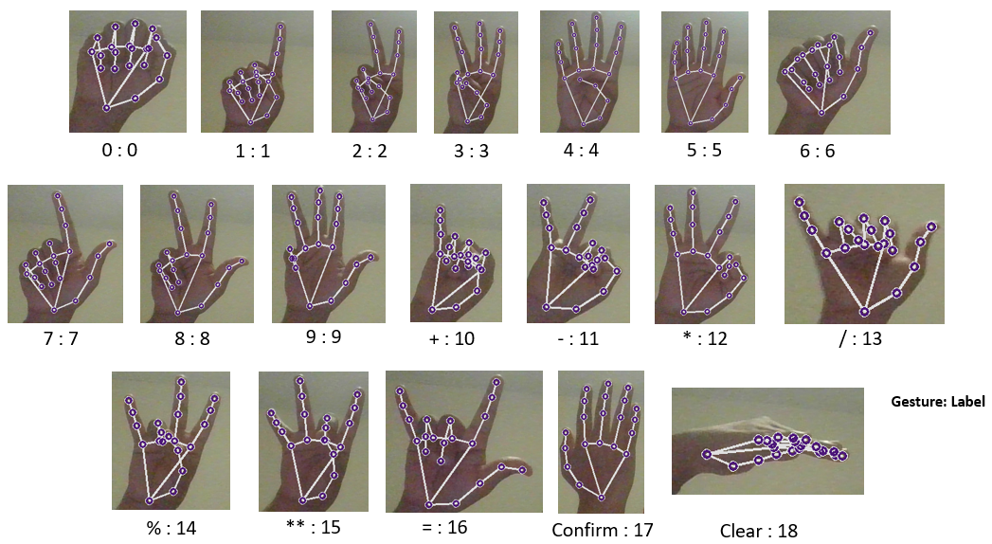
Proposed Solution
We developed a gesture recognition system capable of recognizing different hand gestures and operate a three-digit calculator capable of performing various arithmetic operations such as addition, subtraction, multiplication, division, and modulus.
The data for the nineteen hand gestures has been collected using MediaPipe machine learning (ML) framework developed by Google.
MediaPipe includes palm detection and hand landmark models that can detect hands and can identify 21 hand-knuckle (landmark) coordinates inside the detected hand regions.
The coordinates of hand landmarks for different gestures constitute the data used for developing the hand gesture recognition system. Next, this data has been processed to extract features, which subsequently have been used to train a random forest classifier for hand gesture recognition.
Finally, the hand gesture recognition model has been used to operate a three digit virtual calculator developed using functions from OpenCV library.

Slide 9
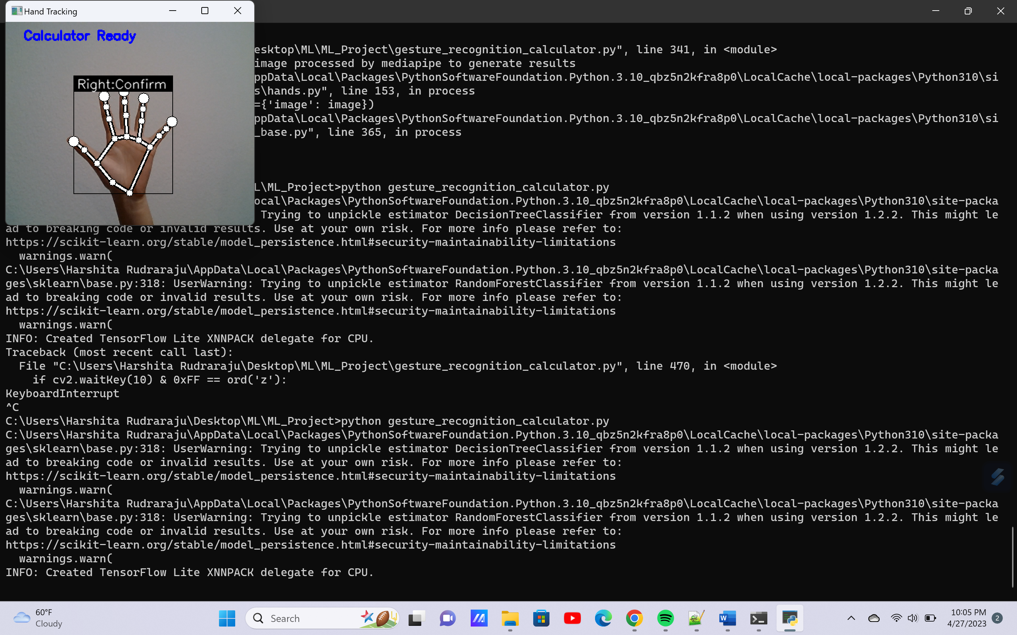
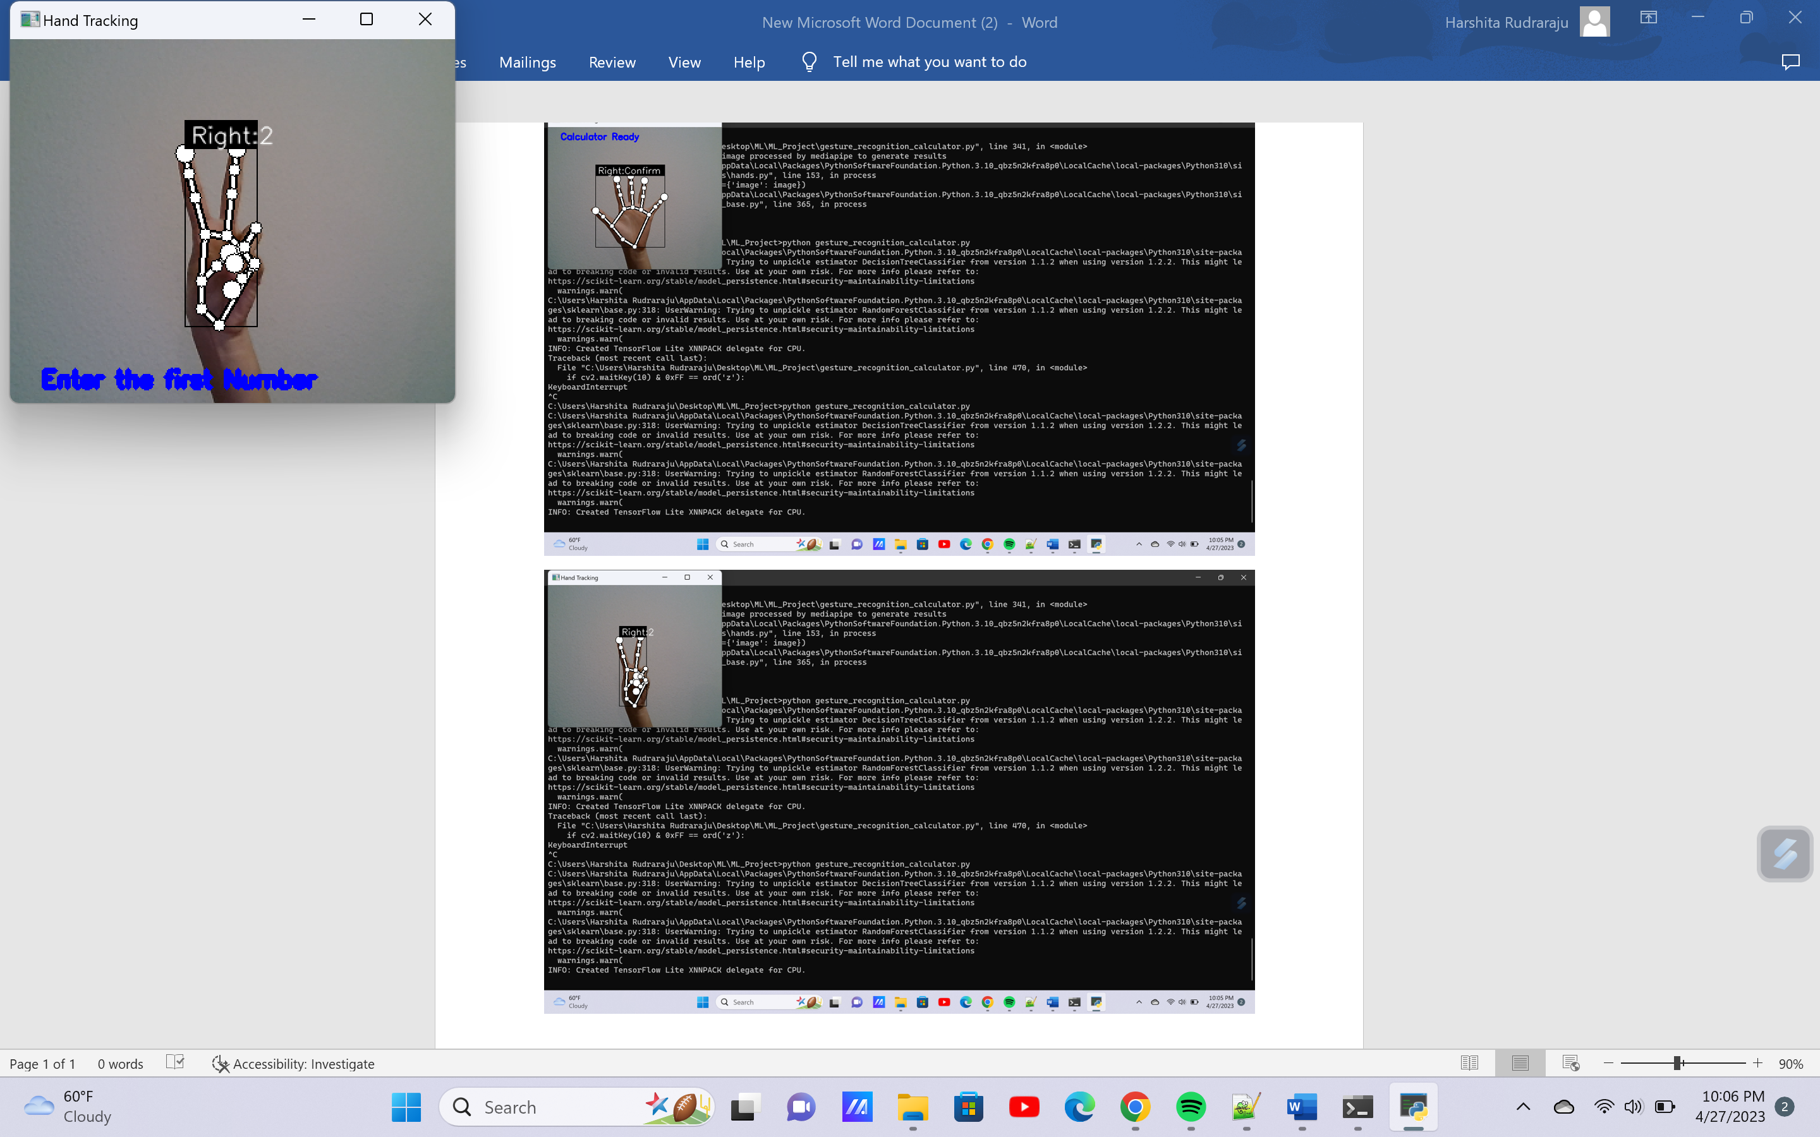
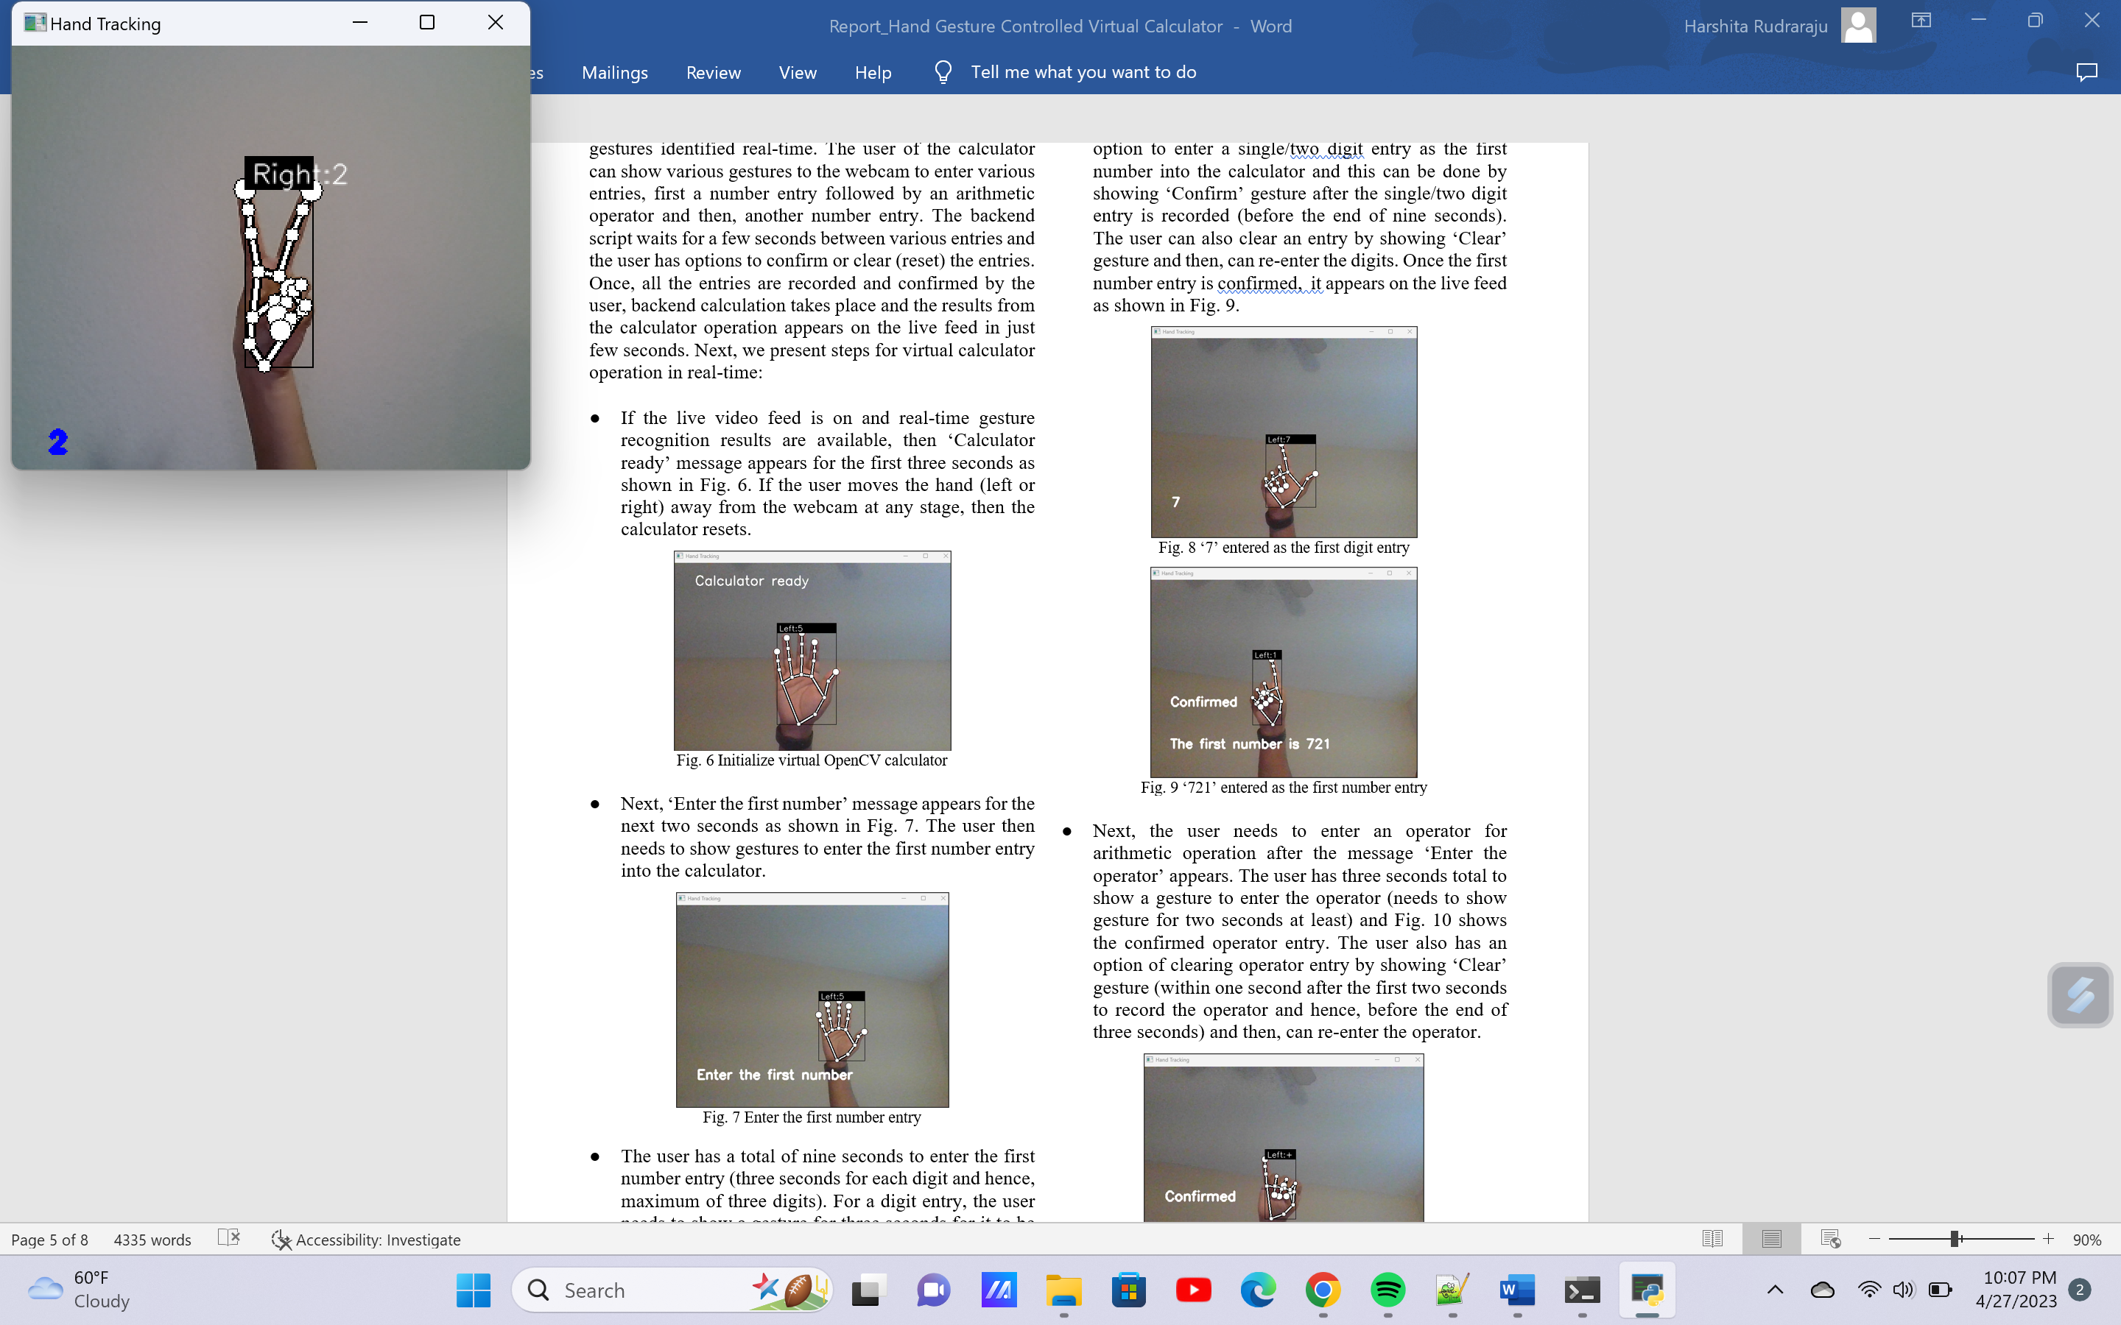
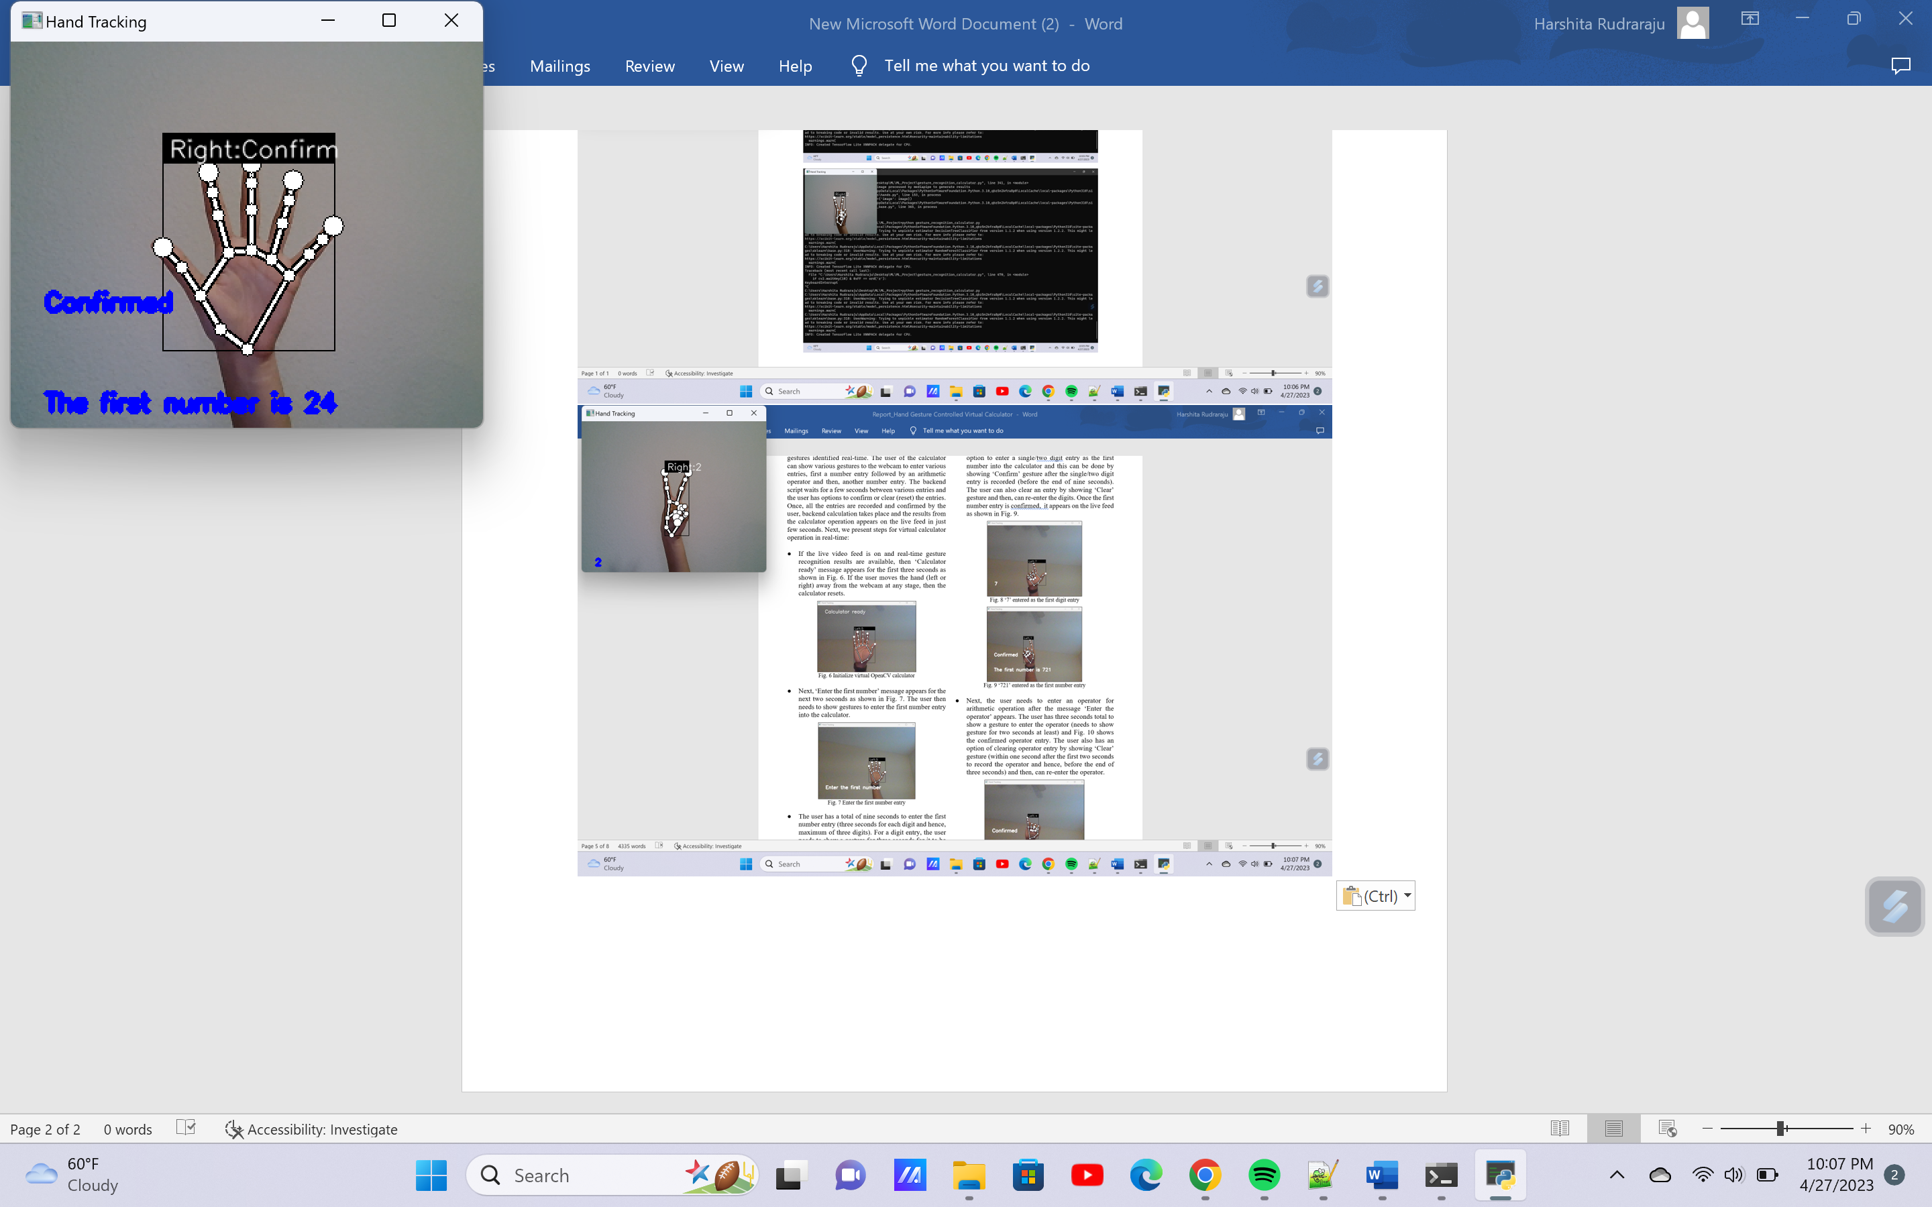
Calculator Implementation
The ‘Calculator Ready’ message appears for the first 3 seconds as shown in Fig.
Next ‘Enter the first Number’ message appears for the next 2 seconds. The user has a total of 9 seconds to enter the first number entry, 3 seconds for each digit, and hence, a maximum of 3 digits. The entry is recorded after showing the ‘confirm’ gesture.

Slide 10
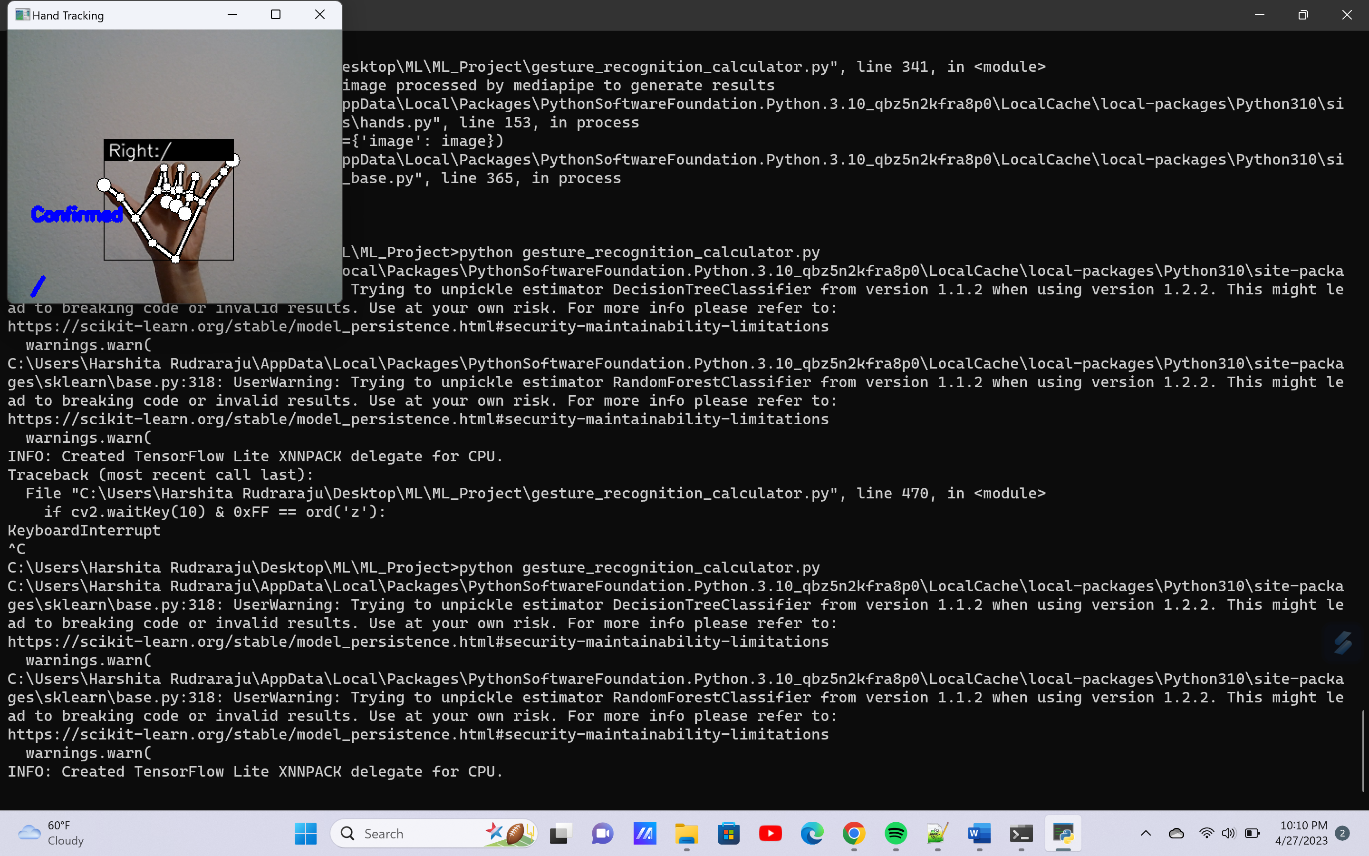
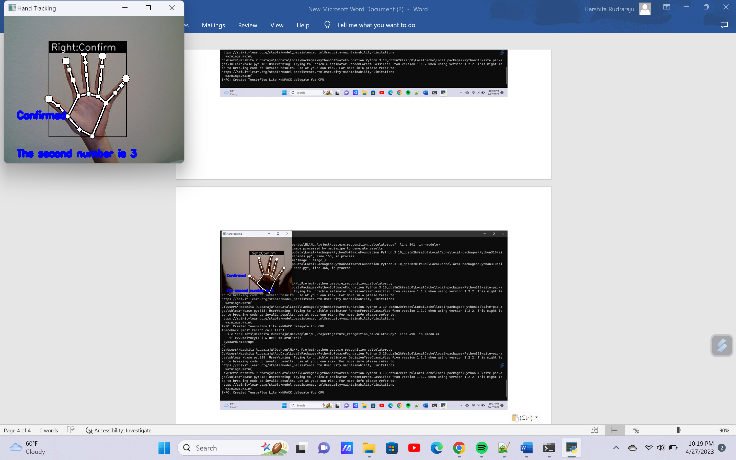
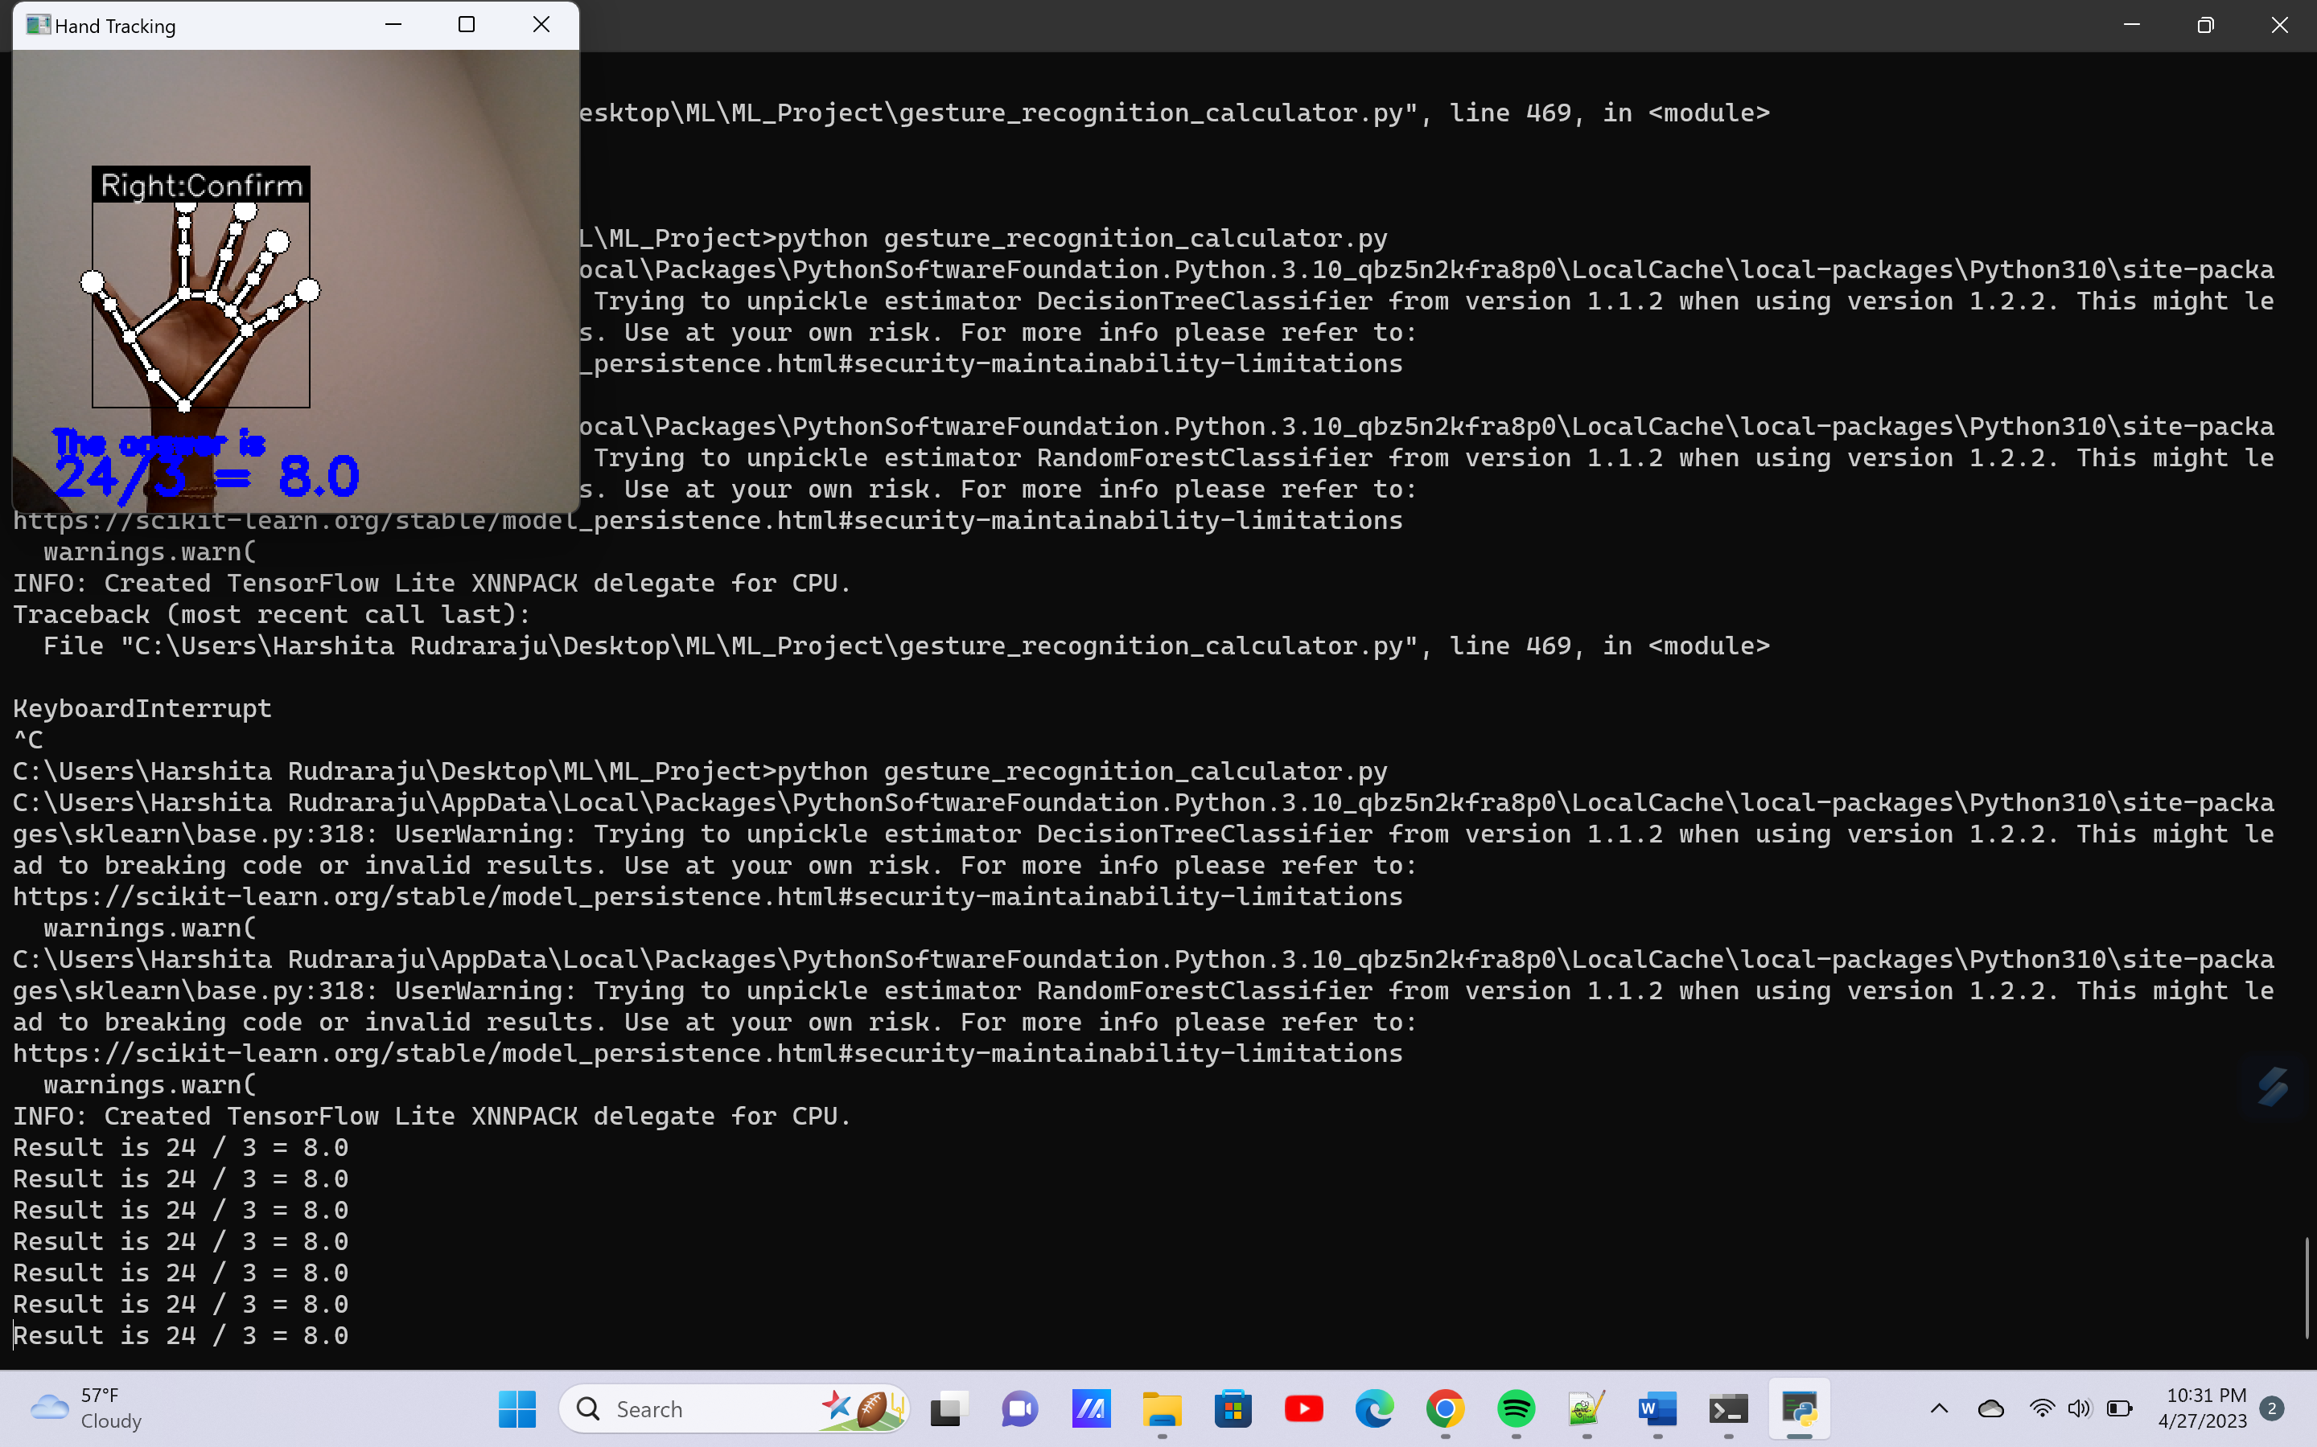
Once the first number is confirmed, ‘enter the operator’ appears.
After confirming the operator, the ‘Enter the second number’ message appears.
Within the next few seconds, once the second number is confirmed, the result appears on the screen.

Slide 11
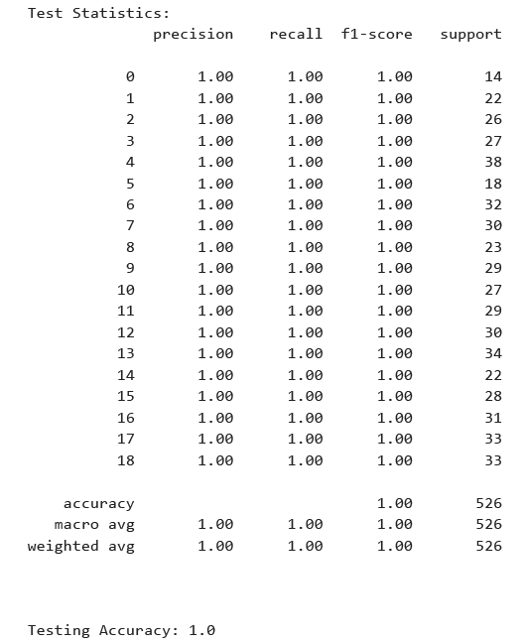
Results & Analysis
A total of 1751 data vectors with feature and gesture label information were collected. About 80-100 data vectors were collected for each of the hand gestures during feature extraction. This data was split into training and test data at 7:3 ratio for gesture recognition model development.
Using the training data, a random forest classifier was trained with 10-fold cross validation and a high average cross validation score of 0.9967 was observed.
The random forest classifier was then tested using the test data set and a test accuracy of 1.0 was observed.

Slide 12
References
Cheok, M. J., Omar, Z., and Jaward, M. H. (2019). A review of hand gesture and sign language recognition techniques. Int. J. Mach. Learn. Cybern. 10, 131–153. doi: 10.1007/s13042-017-0705-5
T. -Y. Pan, W. -L. Tsai, C. -Y. Chang, C. -W. Yeh and M. -C. Hu, "A Hierarchical Hand Gesture Recognition Framework for Sports Referee Training-Based EMG and Accelerometer Sensors," in IEEE Transactions on Cybernetics, vol. 52, no. 5, pp. 3172-3183, May 2022, doi: 10.1109/TCYB.2020.3007173.
Cicirelli, G., Attolico, C., Guaragnella, C., and D'Orazio, T. (2015). A kinect-based gesture recognition approach for a natural human robot interface. Int. J. Adv. Robot. Syst. 12:22. doi: 10.5772/59974
Haria, A., Subramanian, A., Asokkumar, N., Poddar, S., and Nayak, J. S. (2017). Hand gesture recognition for human computer interaction. Proc. Comput. Sci. 115, 367–374. doi: 10.1016/j.procs.2017.09.092
K. S. Abhishek, L. C. F. Qubeley, and D. Ho. Glove-based hand gesture recognition sign language translator using capacitive touch sensor. In 2016 IEEE International Conference on Electron Devices and Solid-State Circuits (EDSSC), pages 334–337, Aug. 2016.
R. Wen, L. Yang, C.-K. Chui, K.-B. Lim, and S. Chang. Intraoperative Visual Guidance and Control Interface for Augmented Reality Robotic Surgery. In 2010 8th IEEE International Conference on Control and Automation, ICCA 2010, pages 947–952, July 2010.
F. Zhang, V. Bazarevsky, A. Vakunov, A. Tkachenka, G. Sung, C.L. Chang, M. Grundmann. MediaPipe Hands: On-device Real-time Hand Tracking. CVPR Workshop on Computer Vision for Augmented and Virtual Reality, Seattle, WA, USA, 2020. arXiv:2006.10214

Slide 13
References
T. Mantecón, C.R. del Blanco, F. Jaureguizar, N. García, “Hand Gesture Recognition using Infrared Imagery Provided by Leap Motion Controller”, Int. Conf. on Advanced Concepts for Intelligent Vision Systems, ACIVS 2016, Lecce, Italy, pp. 47–57, 24–27 Oct. 2016. (doi: 10.1007/978–3–319–48680–2_5)
Tran, D.-S.; Ho, N.-H.; Yang, H.-J.; Baek, E.-T.; Kim, S.-H.; Lee, G. Real-Time Hand Gesture Spotting and Recognition Using RGB-D Camera and 3D Convolutional Neural Network. Appl. Sci. 2020, 10, 722. https://doi.org/10.3390/app10020722
MediaPipe Hands [Online], Available from: https://google.github.io/mediapipe/solutions/hands.html [Accessed 02 Nov 2022].
Hand gesture recognition using MediaPipe [Online], Available from: https://github.com/Kazuhito00/hand-gesture-recognition-using-mediapipe [Accessed 07 Nov 2022].
Hand gesture recognition using MediaPipe [Online], Available from: https://github.com/kinivi/hand-gesture-recognition-mediapipe [Accessed 07 Nov 2022].
Gesture controlled OpenCV calculator [Online], Available from: https://github.com/rishabh-arya/Gesture-controlled-opencv-calculator [Accessed 15 Nov 2022].
OpenCV-Python Tutorials [Online], Available from: https://docs.opencv.org/4.x/d6/d00/tutorial_py_root.html [Accessed 15 Nov 2022]
MediaPipe [Online], Available from: https://google.github.io/mediapipe/ [Accessed 02 Nov 2022].

